Slide 1


Introduction to Software Business Product Management
Week 2 Day 3
Led by: Emily Crose
for
Oakland University

Slide 2
Day 2 Recap

Slide 3

Questions From Day 2?

Slide 4
Terms To Listen For
Application Programming Interface (API)
Enables automated, programmatic retrieval of information using a standard framework.

Slide 5

Network Topology

Slide 6
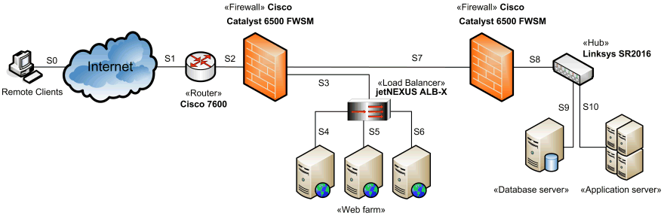
Network Topology

Slide 7
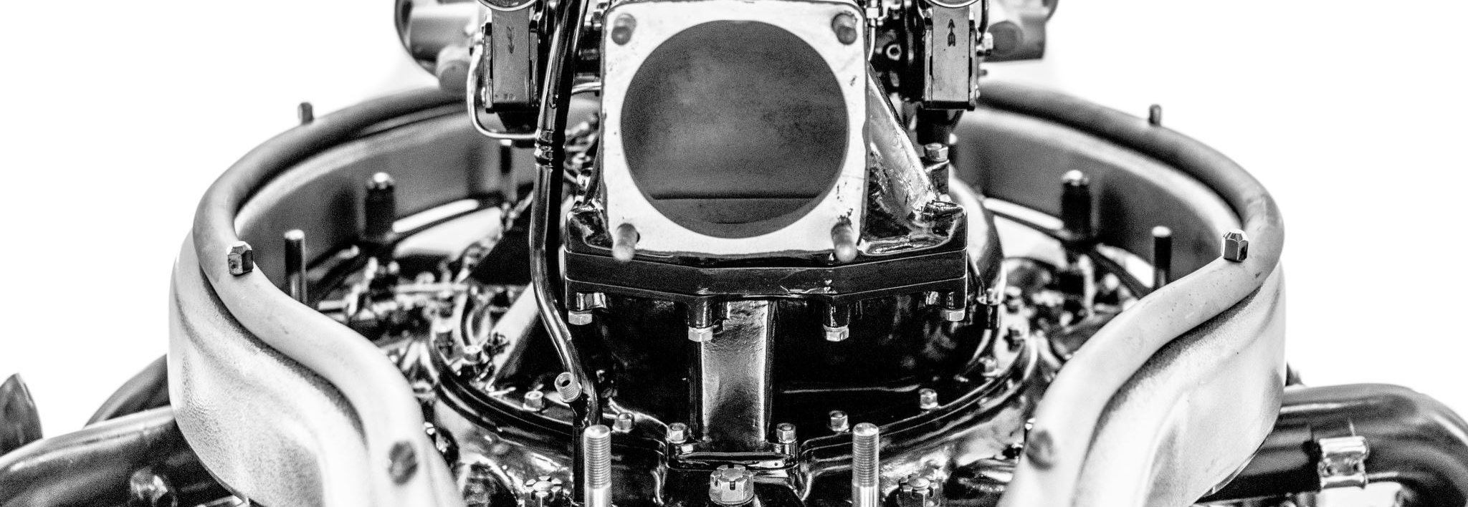

Purdue Model Explained

Slide 8
Purdue Model, What Is It?
A method of arranging and segmenting networked operational technology (OT) devices.

Slide 9
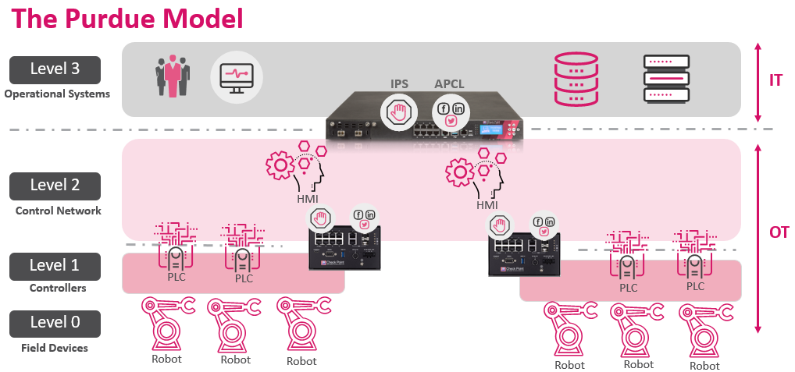

Slide 10
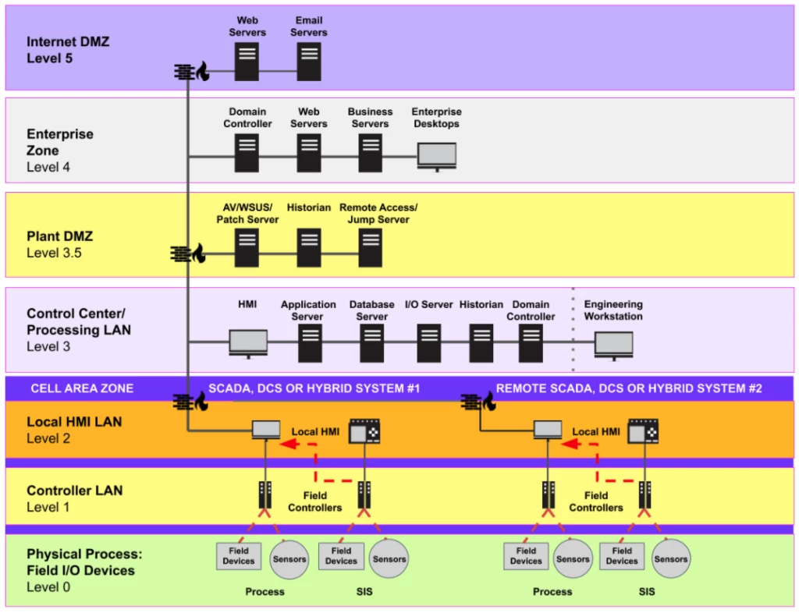

Slide 11
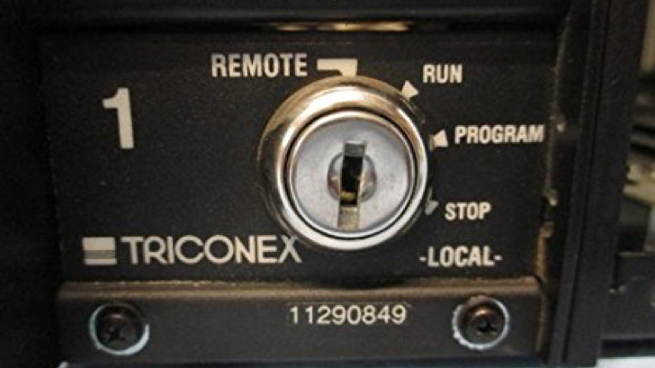
Anatomy Of A Complex OT Attack

Slide 12


Slide 13
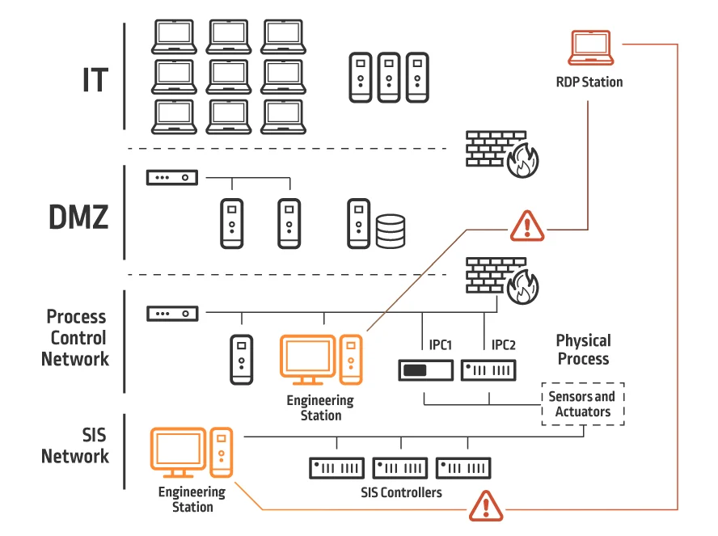
Inside The Victim Network

Slide 14
Separation of Duties
Notes:
We need to keep devices with higher levels of privilege in a special area of the network. We can’t just lump everything together.

Slide 15
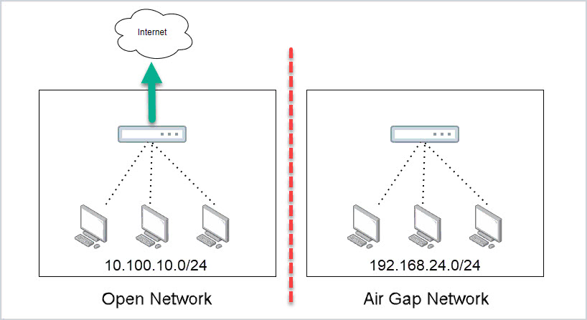
Air Gapped Networks
Notes:
How realistic is this?

Slide 16
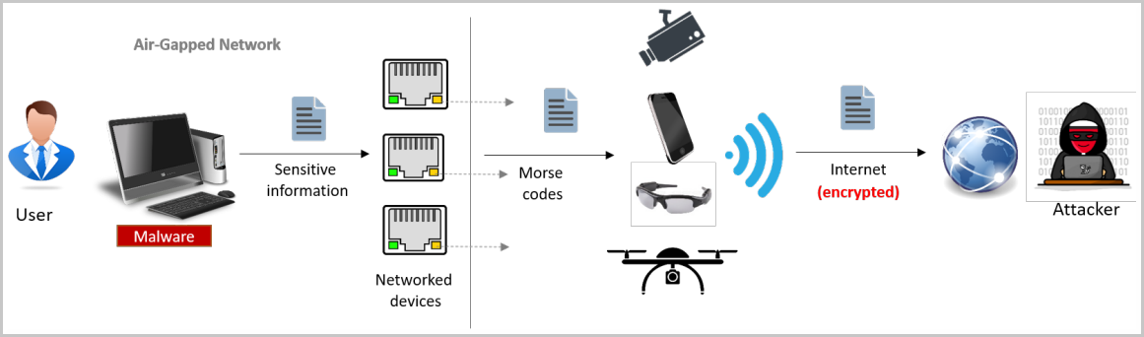
An Interesting Attack
Notes:
Malware on an airgrapped network produces a flash on the network card that can be seen by a camera, maybe attached to a drone of some kind, the flash can then be sent via the internet to an attacker.

Slide 17
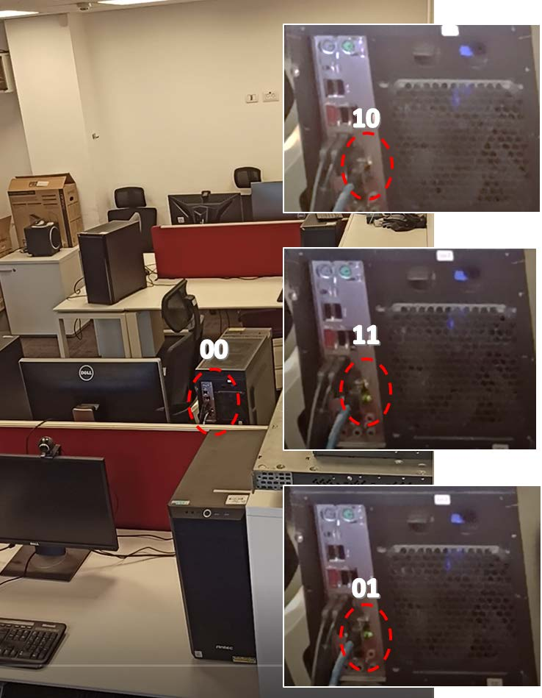
Notes:
Here we can see the lights blinking in a two-bit sequence at a time. Two lights on the network card indicate 4 different states of binary.

Slide 18
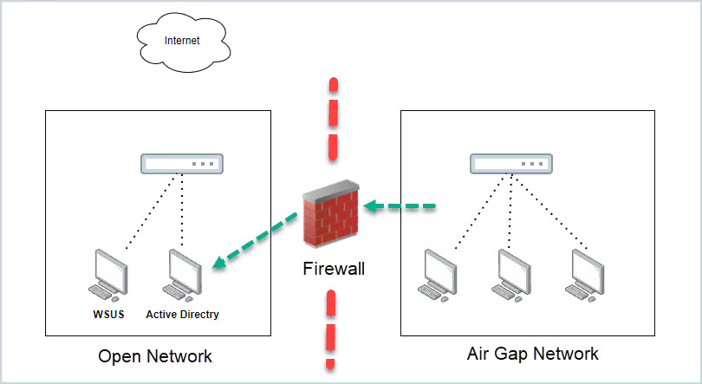
Is This An Airgap?
Notes:
What do we think about this network though? Is this an airgap? So what is the ideal network footprint?

Slide 19


What Does Separation Mean For Development?
Notes:
We need to make sure we’re tracking the changes in the way our networks are built so that we can properly code around it. What does it mean when we make a change to our network architecture that effects our update distribution system?

Slide 20

10 minute break

Slide 21
How Does Software Fit In?

Slide 22

Can This Apply To Cars?
Notes:
Can this same concept apply to cars? Of course it can!

Slide 23
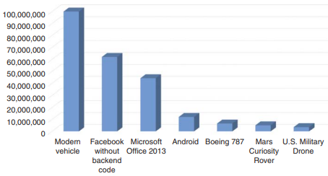
Software By Lines Of Code
Notes:
But when we apply the concept of separation of duties to cars, we have to understand what we’re dealing with. By lines of code, modern cars are among the most complexly coded devices around.

Slide 24
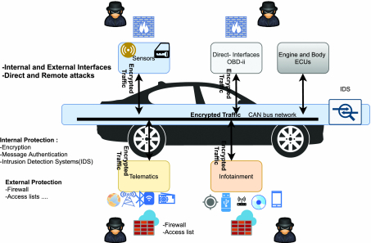
Controller Area Network
Notes:
CAN bus devices operate in an interconnected fashion, very similar to how we build computer networks. Controller devices produce information, and we transfer that information over a local area network that we call the CAN or Controller Area Network. That information is packaged in a way similar to the way we package network packets – we saw this last week.

Slide 25
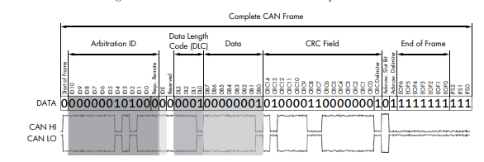
Notes:
This should look at least somewhat similar. The amount of information we’re talking about here is considerably less in CANbus traffic than it is in network packets. It has to be lean because we’re talking about controls that literally make the car move in real time. What you’ll notice about this frame is that there’s nothing here that provides any degree of security.

Slide 26
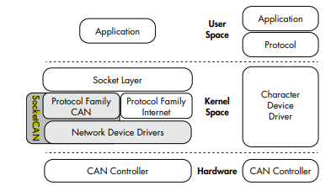
SocketCAN
Notes:
CAN = Controller Area Network
On the right is the CAN, on the left is socketCAN, a newer implementation of the CANbus

Slide 27

Where’s the Security??
Notes:
There’s very little security on the CANbus, but what security does exist is built into session establishment. The thinking is that we don’t necessarily need to build in security because historically, we could access the CANbus directly, and exclusively through an ODB-II reader. But now we have cars being added to wide area networks through a network connection, so there are more ways of accessing cars now.

Slide 28
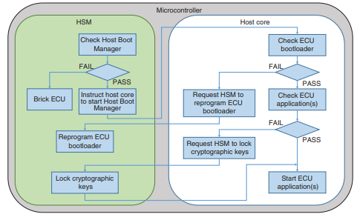
Vehicle Secure Boot
Notes:
In this image we have two main parts of the boot microcontroller, the Hardware Security Model (HSM) and the host core. The role of the HSM is to run through the entirety of the system’s memory before allowing the system to boot. The first thing the HSM does is scans a small part of the system’s memory called the host boot manager. Only when all of the integrity checks pass will the HSM allow the vehicle to boot.

Slide 29
Additional Protocols In Use
ISO-TP
A.K.A. ISO 15765-2
CANopen
GMLAN

Slide 30
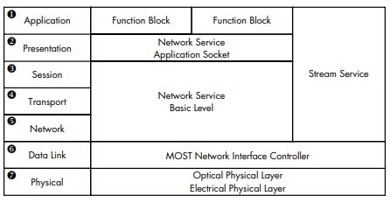
Vehicle Media Systems
Notes:
Vehicle media systems are a part of an interconnection of media devices we call MOST. MOST stands for Media Oriented Systems Transport. Does any part of this look familiar?

Slide 31
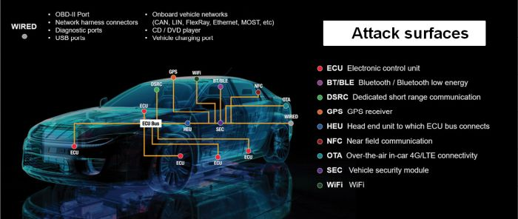
Car Software Attack Surface

Slide 32
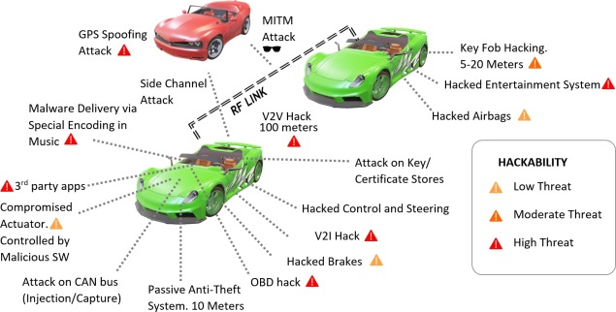
Popular Car Attack Surfaces

Slide 33
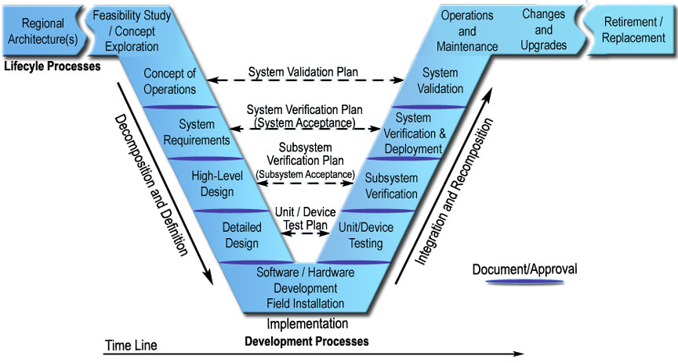
V-Model of Systems engineering

Slide 34
Notes:
We need to talk about the V-model of engineering, which is a document we would have generated during our planning phase. The V-Model will span a space within our build cycle from planning to deployment, so let’s take a close look at this and see how this applies to our build effort. In past classes, we talked a bit about what a V-model might look like in terms of documentation, but we didn’t talk about how the documentation fits into a larger model of engineering design.

Slide 35
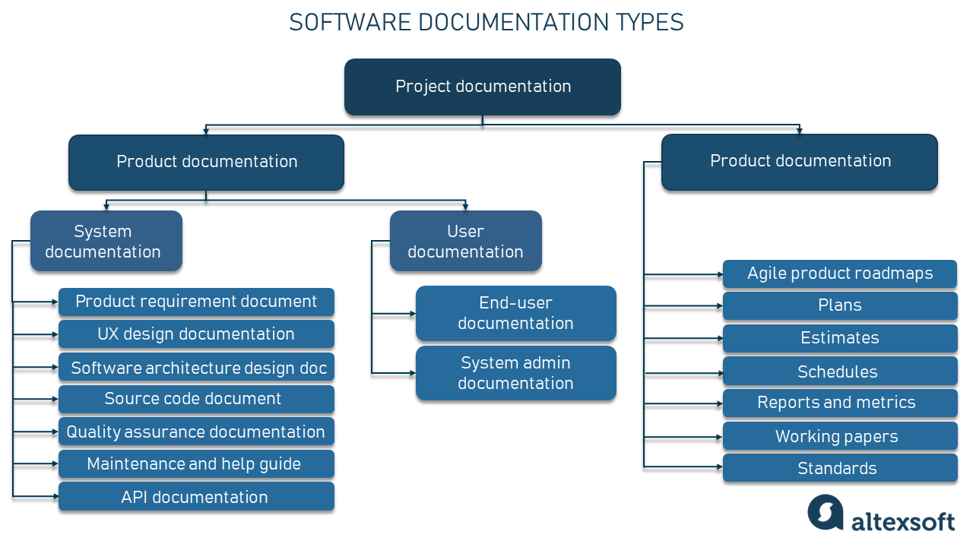
Site/Product Map
Notes:
Site/Product Map

Slide 36
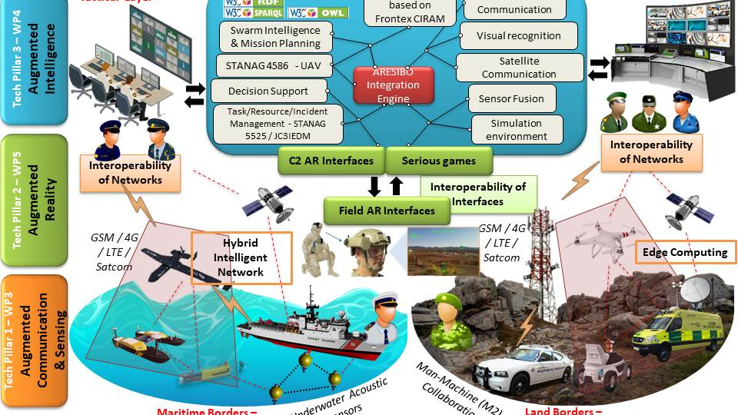
Notes:
This is a military CONOP

Slide 37
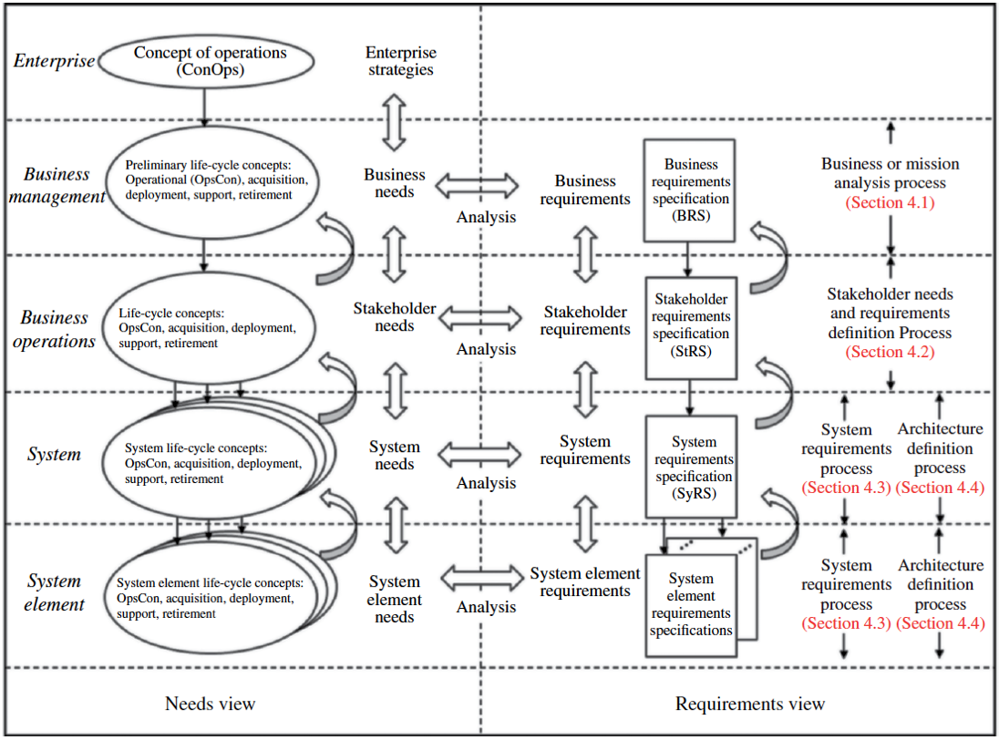
Concept of Operations (CONOP)
Notes:
In past classes, we talked a little about what a Conop is, but let’s see what a CONOP might look like. Here we can see what an example CONOP would look like. The CONOP is a hi

Slide 38
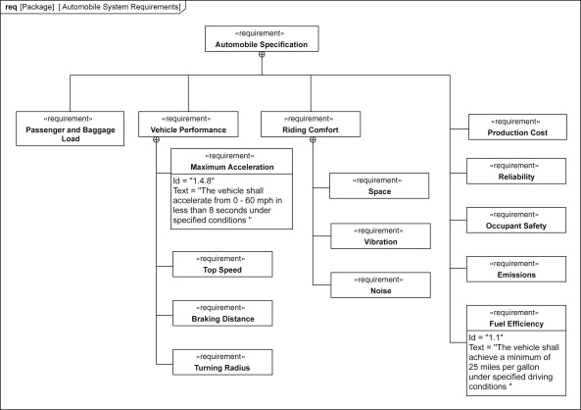
System Requirements Diagram

Slide 39
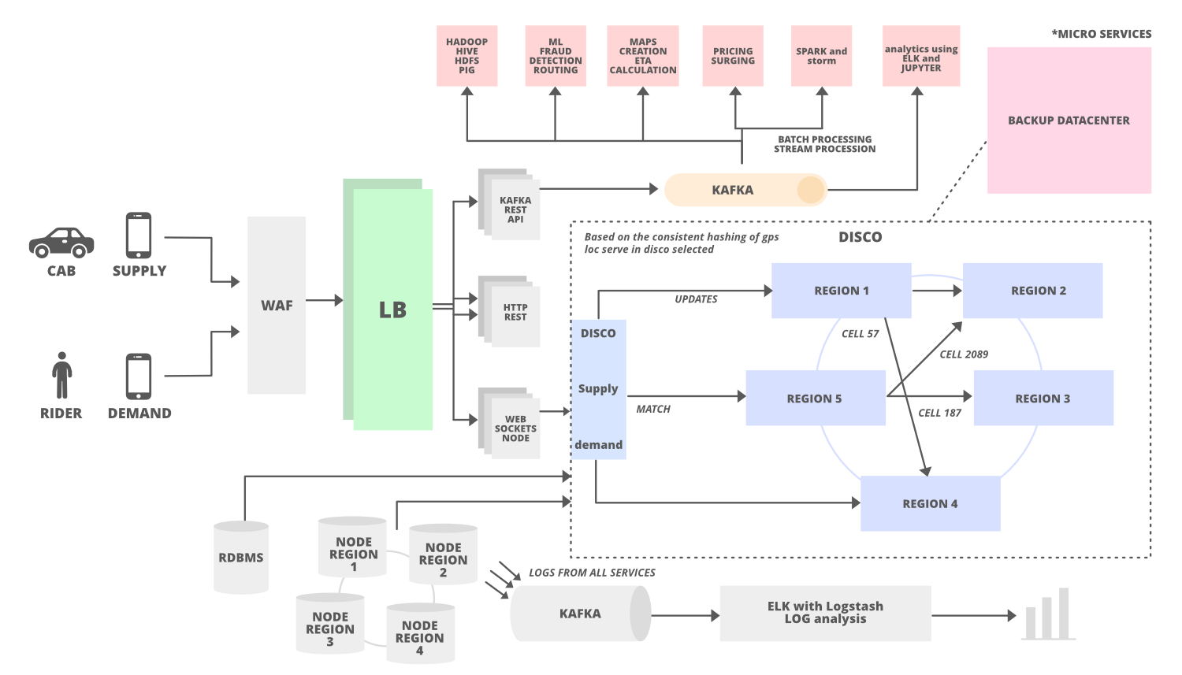
High level design documentation

Slide 40
Detailed Architecture Design documentation
User flow diagram
Site/product map
User story map

Slide 41
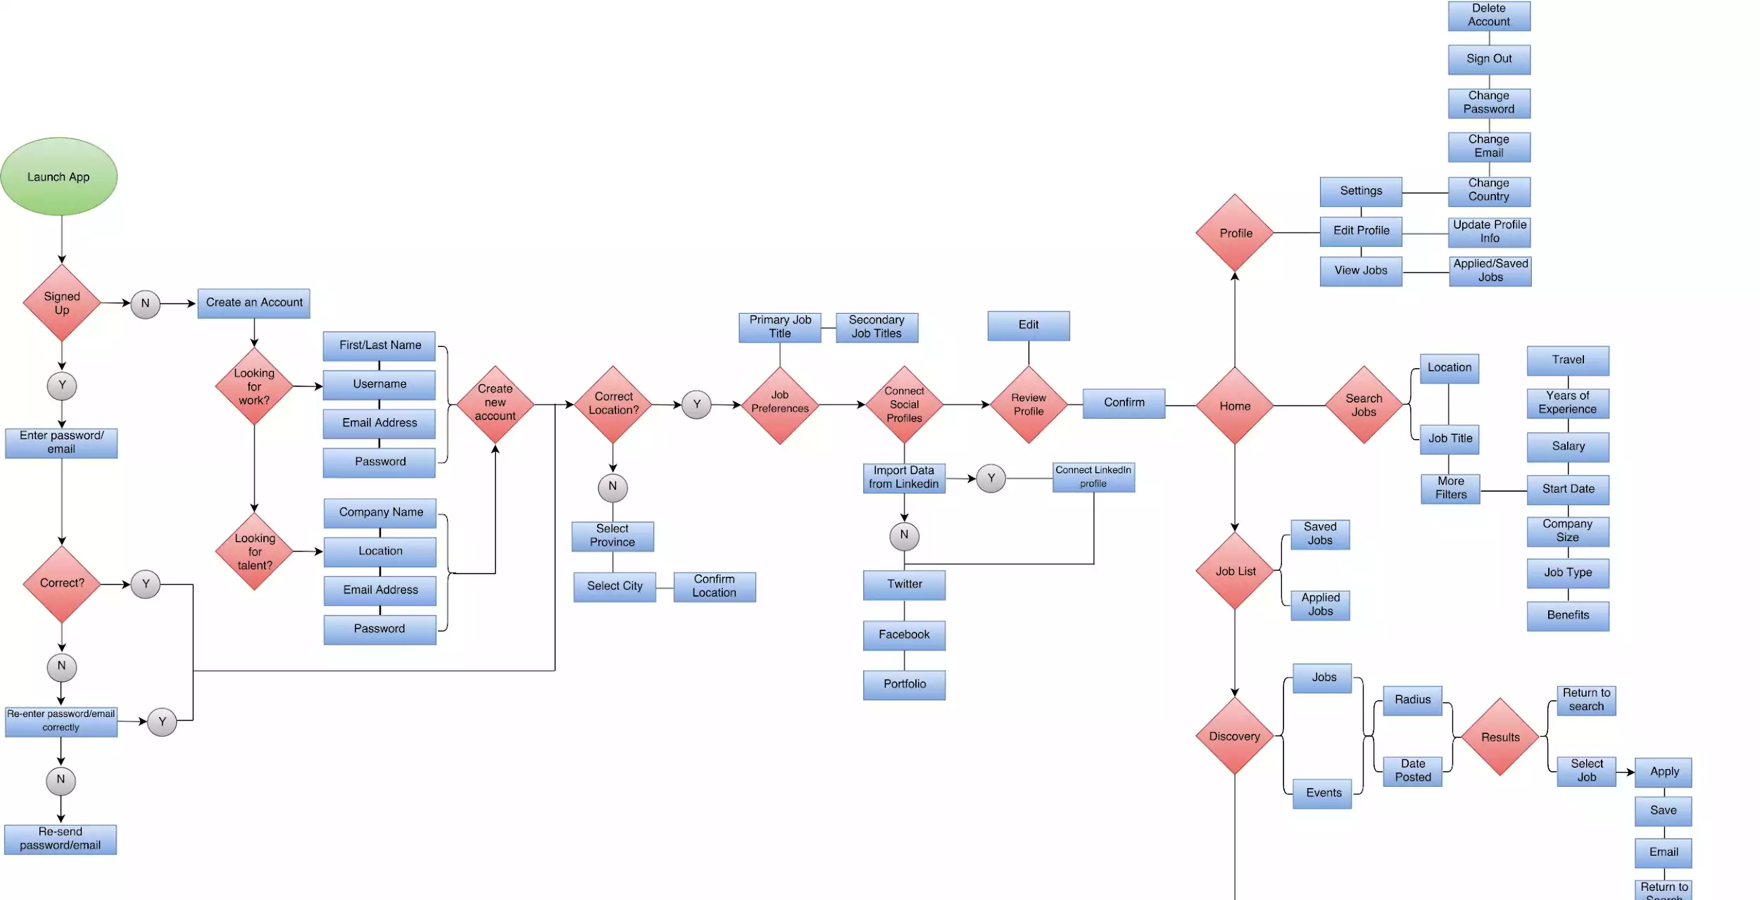
Notes:
This is a user flow diagram

Slide 42
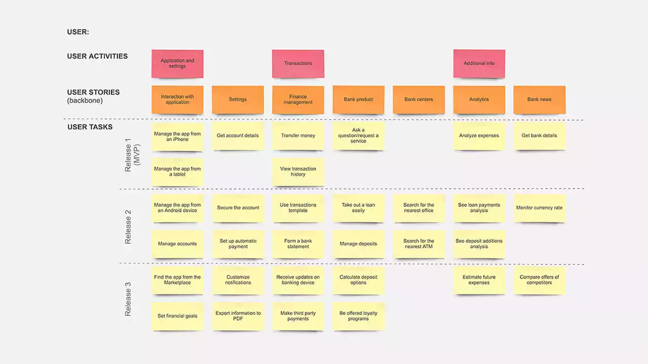
Notes:
This is a User Story Map example

Slide 44

Operations & Maintenance

Slide 45
Automating operations
Environment/Deployment Automation
Jenkins
Chef
Ansible
Pipeline building
Changes & upgrades
Can be easily done with automation scripting!

Slide 46

Retirement & Replacement
Notes:
The image is just here because I thought it was kind of funny. It’s what was suggested by the slide designer

Slide 47
End of life considerations
Can we actually afford to retire this system?
What will replace it?
Will this be transparent to users?
Where will new users go?

Slide 48
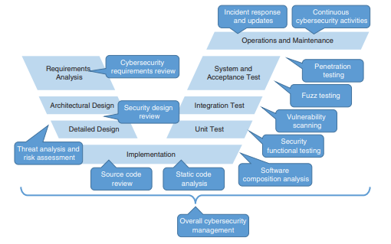
V-Model for Car Engineering

Slide 49

Risk Based Coding For Cars

Slide 50
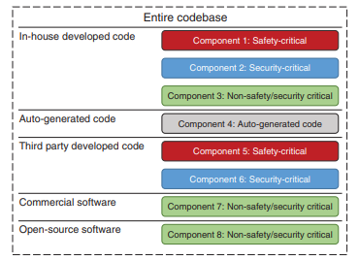
Categorize By Risk
Notes:
What we want to do here is separate our entire codebase by the amount of risk it presents.

Slide 51

References
The Car Hackers Handbook: A Guide For The Penetration Tester by Craig Smith

Slide 52

Question or clarifications?

Slide 53

Review Day 3

Slide 54

Preview Week 3

